Slide 1
Specialized Psychological Texts
Frist year
Second^{ed} semester
Selected by
Prof .Dr. NEAMA A.K.AHMED

Slide 2
PERSONALITY FACTORS

Slide 3
Efforts to identify a single personality profile of the "helpful person" have not been very successful. Rather, it appears that specific personality traits dispose people to help in some types of situations, but not in others. For instance, Satow (1975) found that people with a high need for approval were more likely to donate money to a charity than those low in need for social approval, but only when others were watching them. Presumably, people high in need for approval were motivated by a desire to win praise from others and so acted more prosocially only when their good deeds would be noticed.

Slide 4
In another study people high in the need to be nurturant were most likely to volunteer to give advice about personal problems to a same sex high school student (Gergen, Gergen, & Meter, 1972). But nurturance was not related to willingness to counsel someone of the other sex, or to volunteering to help in a research project, or to assist in preparing course materials. In other words, the link between personality and helping depends on the specific trait in question and on the specific type of assistance needed.

Slide 5
Further insights about the people most likely to help come from studies of people who have helped in extreme real-life situations. In one study, London (1970) interviewed Christians who had lived in Europe during World War II and had risked their lives, often repeatedly, to save Jews from Nazi death camps. All these rescuers had a very strong personal sense of morality, and a close identification with a parent who served as a model of moral conduct

Slide 6
One man recalled his mother teaching him that "regardless of what you do with your life, be honest. When it comes the day you have to make a decision, make the right one" (p. 247). Another characteristic of these people was a sense of adventurousness, a willingness to take risks. Finally, many of the rescuers had also felt somewhat apart from others in their community because of their background or values.

Slide 7
MOOD

Slide 8
There is considerable evidence that people are more willing to help when they are in a good mood. For example, people are more likely to help if they have found a dime in a phone booth (Isen & Simmonds, 1978), been given a free cookie at the college library (Isen & Levin, 1972), succeeded on some experimental tasks (Isen, 1970), or listened to soothing music (Fried & Berkowitz, 1979) than if these mood enhancing events have not occurred. Apparently a warm glow of positive feeling increases the willingness to act prosocially.

Slide 9
There are important limitations to the "feel good" effect, however. First, the effects of positive moods can be quite short-lived—only 20 minutes in one study (Isen, Clark, & Schwartz, 1976). Second, a good mood may actually decrease helpfulness when giving assistance would detract from the person's good mood (Isen & Simmonds, 1978). People in a good mood apparently want to maintain their positive feelings.

Slide 10
The effects of bad mood such as sadness or depression are more complicated, and research results have not been entirely consistent (Cialdini, Baumann, & Kenrick, 1 981). If a bad mood causes us to focus on ourself and our own needs, it may lessen the likelihood of our helping someone else (Thompson, Cowan, & Rosenhan, 1980). On the other hand, if we think helping someone else might make us feel better and so relieve our bad mood, we may actually be more likely to offer assistance.

Slide 11
A further complication is that the link between feeling bad and helping others is clearer in adults than in children (Cialdini et al., 1981). One reason for this may be that children have to learn, as part of growing up, that helping others is a gratifying act that can improve their own feelings.

Slide 12
GUILT

Slide 13
A psychological state with special relevance to prosocial behavior is guilt, the unpleasant feeling aroused when we do something we consider wrong. A desire to reduce feelings of guilt can lead us to help someone we have harmed, or to get rid of our guilt by doing a "good deed."
Several studies have shown that arousing guilt increases helpfulness (Cunningham et al., 1980). In one study (Freedman, Wallington, & Bless, 1967), the experimenter told the subjects it was extremely important that they not know anything about the test they were going to take, and the situation was set up so that virtually all the subjects said they knew nothing about it. Some of the subjects, however, had been told about the test by a confederate

Slide 14
Thus, these subjects were lying to the experimenter. Telling a lie and thereby perhaps ruining an experiment was expected to arouse guilt. It did. There was almost twice as much compliance among the ''liars."
In another experiment by the same researchers, the subjects sat at a table waiting for the experiment to begin.

Slide 15
In some conditions, the table was prepared so that the slightest touch would tip it over and scatter index cards, which had been described as needed for somebody's thesis, all over the room. When the subjects tipped the table, they presumably felt responsible and guilty for mixing up the cards. In one control condition, the table was tipped by a confederate. In another, the table was stable and the cards were not scattered. Once again, there was more helping in the guilt condition than in either control condition.

Slide 16
Other studies suggest that guilty people may have conflicting motivations. On the one hand, they want to make up for their bad deeds by helping the victim or doing good for someone else. On the other hand, they also want to avoid confronting the victim, for fear of discovery, embarrassment, or retaliation. The impact of guilt on helping may be greatest when the guilty person can help without having to confront the victim directly.
An interesting aspect of the relationship between guilt and helping involves the effect of confession

Slide 17
One of the most common assumptions about confession is that it is good for the soul, by which we presumably mean that it is a form of expiation. This, in turn, implies that confession should reduce feelings of guilt. If confession does reduce guilt, it should also reduce helping. Studies by Carlsmith, Ellswonh, and Whiteside (1968) supported this prediction. In the first study, subjects believed they had ruined an experiment because they used information they were not supposed to have. Some were allowed to confess what they had done; others were not given this opportunity; and a third group, who did not think they had ruined the study, served as a control.

Slide 18
All the subjects were asked to volunteer for further experiments.
The results are shown. It is clear that guilt increased helping. Those who used illicit information complied more than those who did not have the information. It is also clear that confessing, which reduced guilt, also reduced helpfulness. Those in the guilt condition who confessed compiled little more than those in the control group.

Slide 19
PERSONAL DISTRESS AND EMPATHIC CONCERN

Slide 20
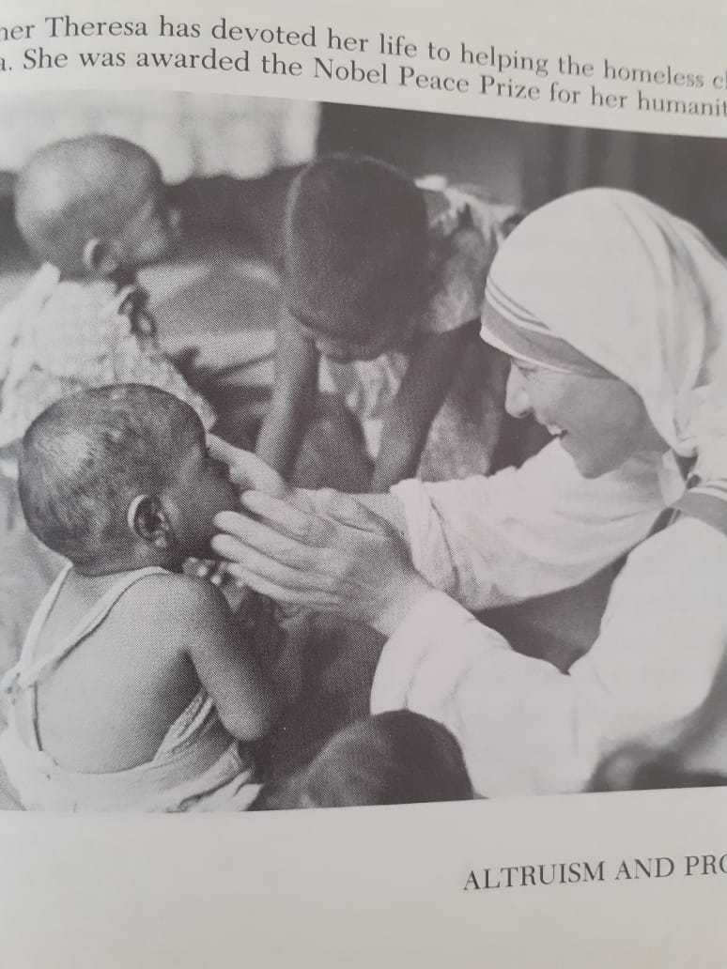

Slide 21
Picture for a moment the sight of people in serious distress: the mangled bodies of victims in a train crash, a starving child in ragged clothes, an anguished father whose child has disappeared.
Witnessing people in need often evokes powerful emotions.

Slide 22
Guilt, Confession, and Helping
CONDITION NUMBER OF HOURS
VOLUNTEERED
Guilt 4.33
Confession 2.67
Control 1.92
Source: Adapted from Carlsmith et al. (1968).

Slide 23
Personal distress refers to our own personal reactions to the suffering of others—our feelings of shock, horror, alarm, concern, helplessness, or whatever. In contrast, empathic concern refers to feelings of sympathy and caring for others, in particular to sharing vicariously or indirectly in the suffering of others. The key difference is that personal distress focuses on the self, whereas empathic concern focuses on the victim. .

Slide 24
Personal distress motivates us to reduce our own discomfort. We might do this by helping a person in need, but we can also do it by escaping from the situation or ignoring the suffering around us. In contrast, empathic concern can be reduced only by actually helping the person in distress. Since the goal of empathic concern is enhancing the welfare of someone else, it would clearly be an altruistic (not self-interested) source of helping behavior.

Slide 25
Several studies have shown that empathy increases prosocial behavior (Hoffman, 1981). For example, in one study (Toi & Batson, 1982) college students learned of the plight of Carol, another student who had broken both legs in a car accident and was seriously behind in her school work. After listening to a tape-recorded interview with Carol, each subject was asked if she would be willing to help Carol

Slide 26
Empathy was manipulated by varying the listening instructions given to subjects. In a high-empathy condition, subjects were told: "Try to take the perspective of the person who is being interviewed, imagining how he or she feels about what has happened and how it has affected his or her life." In a low-empathy condition, subjects were told: "Try to be as objective as possible, carefully attending to all the information presented. . . . Try not to concern yourself with how the person being interviewed feels about what happened."

Slide 27
As expected, subjects in the high-empathy condition experienced significantly greater empathy, as reflected in self-ratings of feeling sympathetic, compassionate, and "moved" by Carol's story. Also as predicted, subjects in the high-empathy condition were significantly more likely to volunteer to help Carol than those in the low-empathy condition, even when it would have been easy to avoid helping (71 vs. 33 percent offered to help). Taking the perspective of someone in distress and sharing his or her suffering can be important factors in prosocial behavior.

Slide 28
The Person in Need

Slide 29
As you near the Student Union, someone approaches you and asks to borrow a dime to make a phone call. Are you more likely to help if the person is a clean-cut preppie type or a punk rocker? Would it matter if the person explained that his or her wallet had been stolen or that he or she had forgotten to bring any change to school? Although the true altruist may be blind to everything but the needs of a person in distress, everyday prosocial behavior is often influenced by characteristics of the person in need.

Slide 30
For example, people on a college campus were more likely to give money to the March of Dimes if they were asked for a donation by a paraplegic woman in a wheelchair than if asked by a nonhandicapped woman (Slochower et al., 1980). In another study (Piliavin, Piliavin, & Rodin, 1975), subway riders in New York City saw a man carrying a cane stumble and fall to the floor. Sometimes the victim had a large red birthmark on his face; sometimes he did not

Slide 31
In this situation, the victim was more likely to receive aid if his face was unblemished (86 percent) than if he had an unattractive birthmark (61 percent). In understanding these and other research findings, two themes seem most important: We are more likely to help people we like and think deserve assistance.

Slide 32
HELPING THOSE WE LIKE

Slide 33
We saw that our initial liking for another person is affected by such factors as physical attractiveness and similarity. Research on prosocial behavior finds that the same characteristics also influence helping. In at least some situations, those who are physically attractive are more likely to receive aid. For example, in a field study (Benson, Karabenick, & Lerner, 1976), researchers placed a completed application to graduate school in a telephone booth at the airport.

Slide 34
The application was stamped and ready to be mailed, but had apparently been "lost." To manipulate appearance, the photo attached to the application was sometimes of a very good-looking person and sometimes of a less attractive person. The measure of helping was whether the individual who found the envelope actually mailed it or not. Results showed that people were much more likely to send in the application if the person in the photo, whether male or female, was attractive.

Slide 35
The degree of similarity between the potential helper and the person in need is also important. Some years ago, researchers (Emswiller, Deaux, & Willits, 1971) had confederates dressed as a "hippie" or as a "straight" approach students and ask to borrow a dime. The researchers also used appearance to categorize the potential helpers as "hippie" or "straight." Results clearly showed that people were most likely to help those similar to themselves. For example, hippie men helped a fellow hippie about 77 percent of the time, but helped a straight person only about 32 percent of the time. There is also evidence that helpfulness is greater toward someone who is from the same country rather than a foreigner (Feldman, 1968), and toward someone with similar attitudes (Tucker et al., 1977).

Slide 36
Prosocial behavior is affected by the type of relationship between people, as everyday experience clearly shows. Whether because of liking, social obligation, self-interest, or empathy, we are more helpful to intimates than to strangers. One study (Bar-Tal et al., 1977) examined college students' expectations about receiving help from parents, siblings, close friends, acquaintances, or strangers. Results indicated that the closer the relationship, the stronger the expectation that help should be given, the less gratitude expressed when help is given, and the more resentment felt if help is refused.

Slide 37
HELPING THOSE WHO DESERVE HELP

Slide 38
Whether a person receives help depends in part on the "merits" of the case. For example, people in a supermarket were more likely to give someone money so they could buy milk rather than cookie dough (Bickman & Kamzan, 1973), presumably because milk is more essential for health than cookies. Passengers on a New York subway were more likely to help a man who fell to the ground if he appeared to be sick rather than drunk (Piliavin, Rodin, & Piliavin, 1969).

Slide 39
In both cases, the legitimacy or appropriateness of the request or problem made a difference. Of course, judgments about the importance of a particular need may be strongly influenced by values.
In addition to evaluating the deservingness of the need itself, potential helpers may also make inferences about the causes of the person's need, following the principles of causal attribution. A teacher might, for example, spend more time helping a student who missed classes because of a death in the family rather than because of a trip to the Carribbean.

Slide 40
Several studies indicate that the key causal factor is personal control: We are more likely to help someone if we believe the cause of the problem was outside the person's control. For instance, in one study (Meyer & Mulherin, 1980), college students said they would be more willing to lend rent money to an acquaintance if the need arose due to illness (an uncontrollable cause) rather than laziness (a controllable cause).

Slide 41
In another study (Weiner, 1980), students said they would be more likely to lend their lecture notes to a classmate who needed them because of something uncontrollable, such as the professor's being a poor lecturer, rather than something controllable, such as the classmate's not trying to take good notes. If a person could have prevented the predicament by his or her own actions, we are less likely to help

Slide 42
Attributions may also influence how we feel about a person in need. We may feel sympathy and concern for those who suffer through no fault of their own; we may feel anger and disgust toward those who are responsible for their own problems (Meyer & Mulherin, 1980; Weiner, 1980).
Our focus up to now has been on factors that affect whether or not help is given. In the next section we look at helping from a different perspective—that of the person receiving aid.

Slide 43
THE EXPERIENCE OF RECEIVING HELP

Slide 44
Sometimes we react to getting help with happiness and gratitude. The novice swimmer saved from drowning by an alert lifeguard is thankful to be alive and grateful for getting help when it was needed. The student who gets a ride to the airport from a friend is genuinely thankful for the favor. But there are also instances when people react negatively to receiving help. When Dad offers to help his five-year-old get dressed, she may indignantly insist she'd rather do it herself.

Slide 45
Welfare recipients may react toward social workers with veiled hostility rather than warmth. Countries receiving millions in U.S. foreign aid complain about American policies and "exploitation" of developing nations. What these examples point out is that receiving help can be a mixed blessing. Several social psychological theories help explain these reactions.

