Slide 1
Specialized Psychological Texts
Frist year
Second^{ed} semester
Selected by
Prof .Dr. NEAMA A.K.AHMED

Slide 2
Deciding to Help

Slide 3
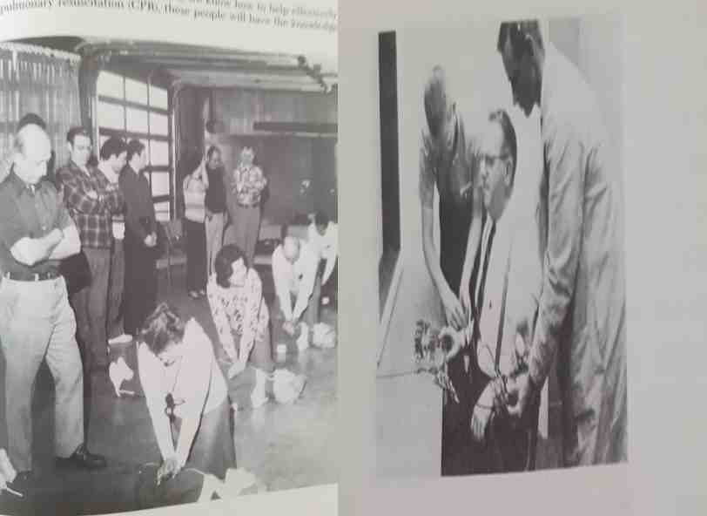

Slide 4
So far, we have discussed general ways in which biological dispositions, social norms, and previous learning experiences can influence helping. But even the most motivated altruist does not offer aid all the time. In any particular situation, the decision to help involves complex processes of social cognition and rational decision-making (see Latane & Darley, 1970; Schwartz, 1 977).

Slide 5
A person must first notice that something is happening and decide whether or not help is required. If help is needed, the person may consider the extent of his or her own personal responsibility to act. Third, the person may evaluate the rewards and costs of helping or not helping. Finally, the person must decide what type of help is needed, and just how to provide it.

Slide 6
PERCEIVING A NEED

Slide 7
It's 2 A.M. and a piercing shriek fills the night air. Some people sleep on, oblivious to all but their private dreams. You wake up with a start. A woman shouts, "Stop it! Leave me alone!" You hear an angry male voice, but you can't quite make out what he's saying. Quickly you ask yourself what is going on—is it merely a noisy lovers' quarrel, or a serious physical attack? Is this an emergency requiring outside intervention?

Slide 8
The crucial first step in any prosocial act is noticing that something is happening and deciding help is required. In some situations, the need is clear: Flood waters are rising in the river in your town and all able-bodied people are needed to fill sandbags to hold back the water; your child has gashed her head playing soccer and needs medical attention. But in many situations, such as hearing screams in the night it can be difficult to decide.

Slide 9
Uncertainty about a situation is a major reason-why people sometimes fail to offer assistance (see Clark & Word, 1974; Solomon,-Solomon, & Stone, 1978). For example, one- study (dark &' Word, 1972) found that when students heard an unmistakable emergency -a maintenance man falling off a ladder and crying but in agony—all of them went to the man's aid. In another condition, where students heard an ambiguous emergency—the sounds of an identical fall but without verbal cues that the victim was injured-help was offered only about 30 percent of the time.

Slide 10
What cues do people use in deciding whether there is an emergency requiring intervention? Research by Shotland and Huston (1979) identified five important characteristics which lead to the perception that an event is an emergency:
1. Something happens suddenly and unexpectedly.
2. There is a clear threat of harm to a victim.
3. The harm to the victim is likely to increase over time unless someone intervenes.

Slide 11
4. The victim is helpless and needs outside assistance.
5. Some sort of effective intervention is possible.
For example, most people considered a drug overdose, a heart attack, a rape in progress, and a car accident with the driver motionless on the ground to be emergencies. People were less certain about whether an emergency existed if
there was a power blackout, if a friend said he was miserable and depressed/or if there was a disabled car on the side of a road.

Slide 12
Our interpretation or definition of a situation is a vital factor in whether or not we offer aid. Shotland and Straw (1976) showed that people respond quite differently to an identical fight scene, depending on whether they perceive it as a lovers' quarrel or a fight between strangers. In this study, students came to the psychology department individually in the evening to fill out an attitude questionnaire.

Slide 13
While working on the task, the student heard a loud fight break out in the corridor (actually staged by drama students). A woman screamed and pleaded with a man to "get away from me." In a "marriage" condition, where the victim yelled "I don't know why I ever married you," only 19 percent of students intervened. But in a "stranger" condition, where the woman yelled, "I don't know you," 65 percent of subjects intervened either directly or by calling the police.

Slide 14
Even though the fights were identical in all respects, subjects perceived the situation as more serious and the woman as more eager for help in the stranger condition.
In a real-life fight where the relationship between people is unclear, onlookers may assume it to be a lovers' quarrel and so decide not to intrude. Perhaps this is unfortunate, but it means that the lack of help is often due to misinterpretation of the situation, not to unwillingness to help.

Slide 15
TAKING PERSONAL RESPONSIBILITY

Slide 16
You're at the beach, lying in the sun. A woman spreads her blanket near yours and turns on her portable radio to a local rock station. After a few minutes she goes for a swim, leaving her radio on the blanket. A bit later a man comes along, notices the radio, snatches it up quickly, and walks off. What do you do? Chances are that you do not try to stop the theft—reminding yourself, perhaps, that it's not your responsibility.

Slide 17
In an experiment re-creating the scene just described (Moriarity, 1975), only 20 percent of people intervened by going up to the thief and demanding an explanation. In a second condition, however, the owner of the radio first approached the person next to her on the beach and asked if they would "watch my things." Once such a commitment had been established,
95 percent of people intervened to stop the thief. When individuals feel personal responsibility, they are significantly more likely to act in a prosocial way.

Slide 18
Another demonstration of the importance of taking personal responsibility comes from a recent field study (Maruyama, Fraser, & Miller, 1982). Groups of children who came to a certain house while trick-or-treating for Halloween were asked to donate candies for hospitalized children. There were three experimental conditions, designed to manipulate the children's perceptions of responsibility.

Slide 19
In one condition, the woman who greeted the kids made each child responsible-for donating candies by putting the child's name on a bag for the candies, in another condition, she made one child responsible for the entire group, in the third condition, no one was given responsibility.
The variations in responsibility had clear effects on the number of candies donated by the children. When each child was individually responsible, the average donation was 5 candies; when one child was responsible for the group, this dropped to 3.3; when no one was responsible, an average of only 2.2 candies per child was given.

Slide 20
Another factor influencing perceived responsibility is competence (Bickman, 197 I). We apparently feel a greater sense of obligation to-in-tervene in a situation where we have the skills to help effectively. In one study; for instance (Clark & Word, 1974), participants witnessed a person (actually a confederate) pass out from an electrical shock from malfunctioning equipment. Of participants who had formal training or experience in working with electrical equipment, 90 percent intervened to help; among those with no electrical skills, only 58 percent intervened.

Slide 21
WEIGHING THE COSTS AND BENEFITS

Slide 22
According to the incentive theories described, people consider the potential gains and losses that will result from a particular action, including helping another person (see Lynch & Cohen, 1978; Piliavin et al., 1981). So a person will act prosocially when the perceived profits (rewards — costs) for helping outweigh the profits from not helping.

Slide 23
Sometimes it is relatively easy to help; at other times, helping may involve considerable costs in time, energy, and complications. If someone asks you for directions, it is easy to stop for a moment and help out if you can. But if you are driving along a highway and see someone stuck at the side of the road, it is much more time-consuming to stop to help. In both situations, the costs will depend in part on whether you perceive any possible threat to your own safety. Does the person needing help look respectable, or is there some chance that you will be robbed? The greater the perceived costs, the less likely you are to help.

Slide 24
There is also some cost to not giving assistance. You may feel guilty about not helping. Other people may see that you have not been helpful, and you will feel badly because they may have a poor opinion of you. You may have a general moral value that says you should help if you can, and not helping will make you feel that you have not been a good person. Thoughts such as these influence whether or not you offer help.

Slide 25
On the other hand, there are benefits to helping which provide positive incentives. The greater the good you perceive you will do, the more likely you are to help. The more the person deserves to be helped, and the more help you are able to give, the better you may feel about offering assistance. For example. Cruder, Romer, and Korth (1978) had a female confederate telephone people and request aid. The woman's story was that her car had broken down and she needed to reach a service station. She had gotten a wrong number, and asked the person to call the station for her

Slide 26
In some cases, she was in great need; in others less. In some cases, her problem was largely her fault because she said she had forgotten to take the car in for service even though she knew it needed repairs; in others, it was not her fault—the car had broken down with no warning. People helped more when her need was greater and when she was not at fault, and therefore presumably was more deserving of help.

Slide 27
Several researchers (see Lynch & Cohen, 1978; Morgan, 1978; Morgan & Leik, 1979) have tested this model of helping and have found generally supportive results. It seems likely that cost-benefit considerations do influence helping, at least in some situations. On the other hand, they do not fully explain all helping decisions. The person who instantly rushes into a burning building to save a child is unlikely to have weighed carefully the expected utility of the action. Rather, such acts may be motivated by basic emotions and values having to do with human life, courage, and so on.

Slide 28
DECIDING HOW TO HELP AND TAKING ACTION

Slide 29
A final element in the decision to help is figuring out what type of assistance to offer, and then taking action. Should you intervene directly in the fight outside your door, or act indirectly by calling the police? Should you try to administer CPR to the accident victim, or call the paramedics? Whether a person takes direct action or seeks further assistance from someone else depends on many factors, such as the type of aid needed and the expertise or physical size of the potential helper.

Slide 30
In emergencies, decisions are often made under great stress, urgency, and sometimes even personal danger. Unfortunately, sometimes well-intentioned helpers are not able to give assistance or may even mistakenly do the wrong thing.
Our analysis of different elements in the decision to help highlights the many reasons why people may fail to give needed assistance. They may not notice that a problem exists, or may misperceive the situation as a trivial problem. They may recognize a need, but not feel personally responsible for helping. They may believe the costs of helping are too great. They may want to help, but be unable to. Or they may hesitate, caught in a state of indecision.

