Slide 1
المصدر
ا.د/ صابر امين دسوقى
د/ اسلام سلامه
كلية الاداب جامعة -بنها
د اسلام سلامه محمد اعداد /
كلية الاداب
قسم الجغرافيا
الفرقة الثالثة
المحاضرة الاولى
مادة النصوص الجغرافية

Slide 2
Geographical terms
Dr. Islam Salama

Slide 3
Index of study topics Physical geography
Definition of physical geography
Physical geography is concerned with the study of four main branches
Sub-Branches of Physical Geography

Slide 4
Chapter 1
Layers of the Earth

Slide 5
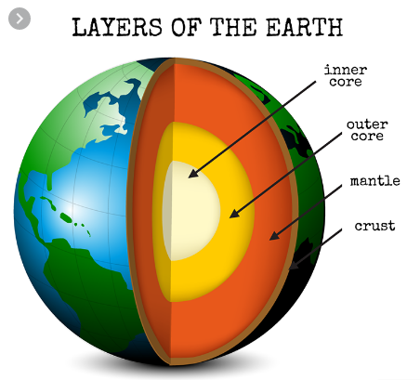

Slide 6
Chapter 2
What's the difference between minerals and rocks?

Slide 7
Chapter 3
Weathering and Erosion and the Rock Cycle
Chemical Weathering
Mechanical Weathering
Erosion

Slide 8
Chapter 4
What is the difference between folding and faults?

Slide 9
Chapter 5
Mass Wasting of Slopes

Slide 10
Chapter 6
Geomorphologic terms
References

Slide 11
Questions
What is the meaning of physical geography?
What are the branches of physical geography
Write down 20 geographic terms you learned
I wish you happy times

